Slide 1
A Network Science Approach to the World of Painters
Eliseu Antonio Kloster Filho†
† Department of Physics and Astronomy, Northwestern University, Evanston, IL, USA

Slide 2
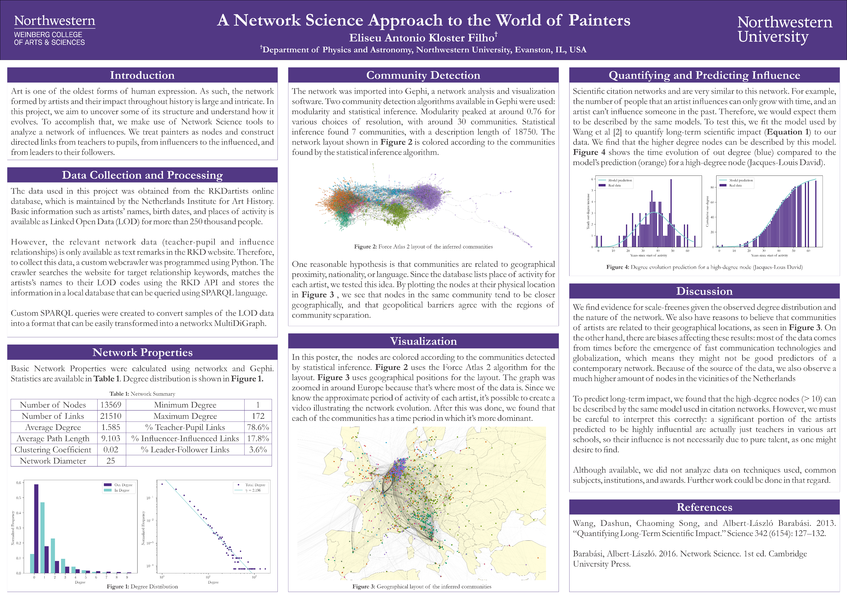

Slide 5
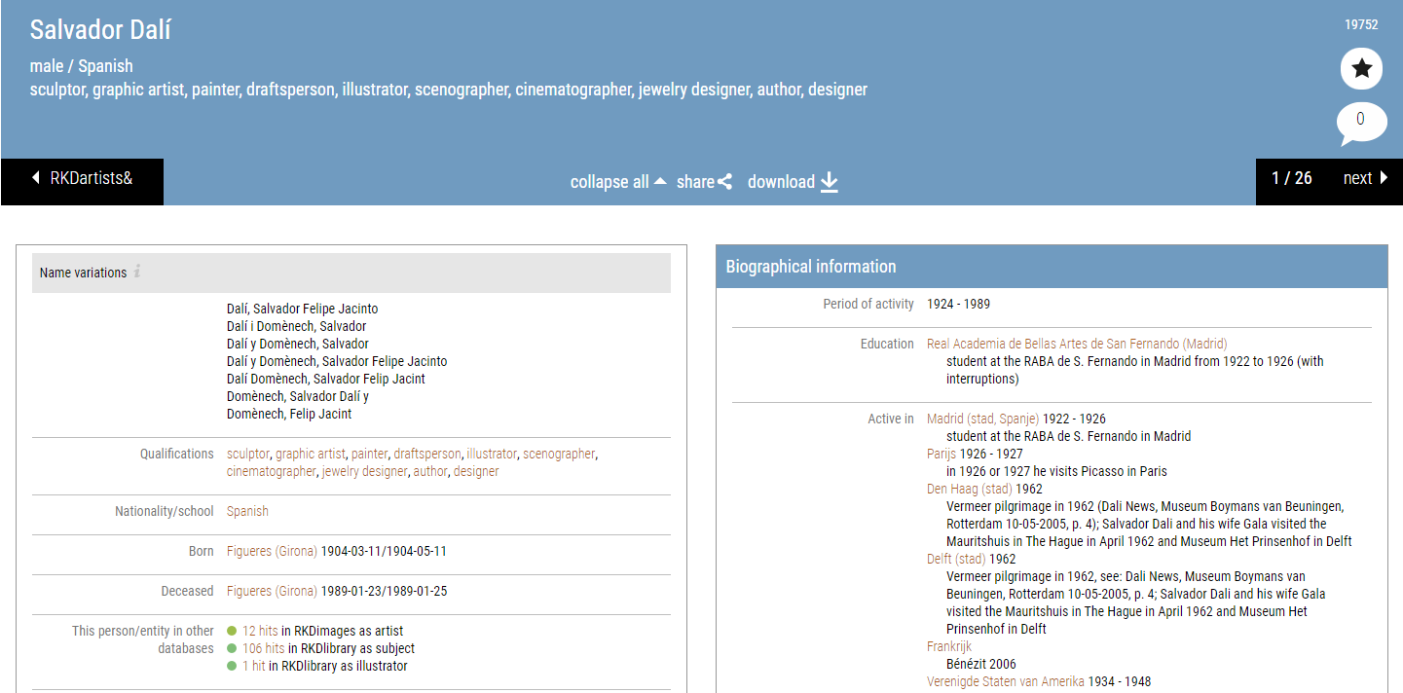

Slide 6
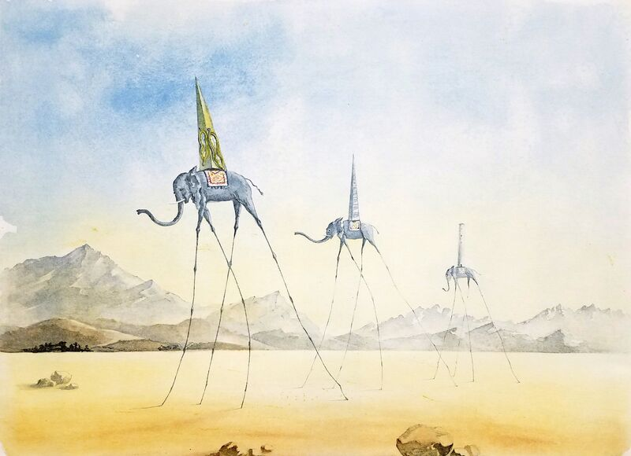
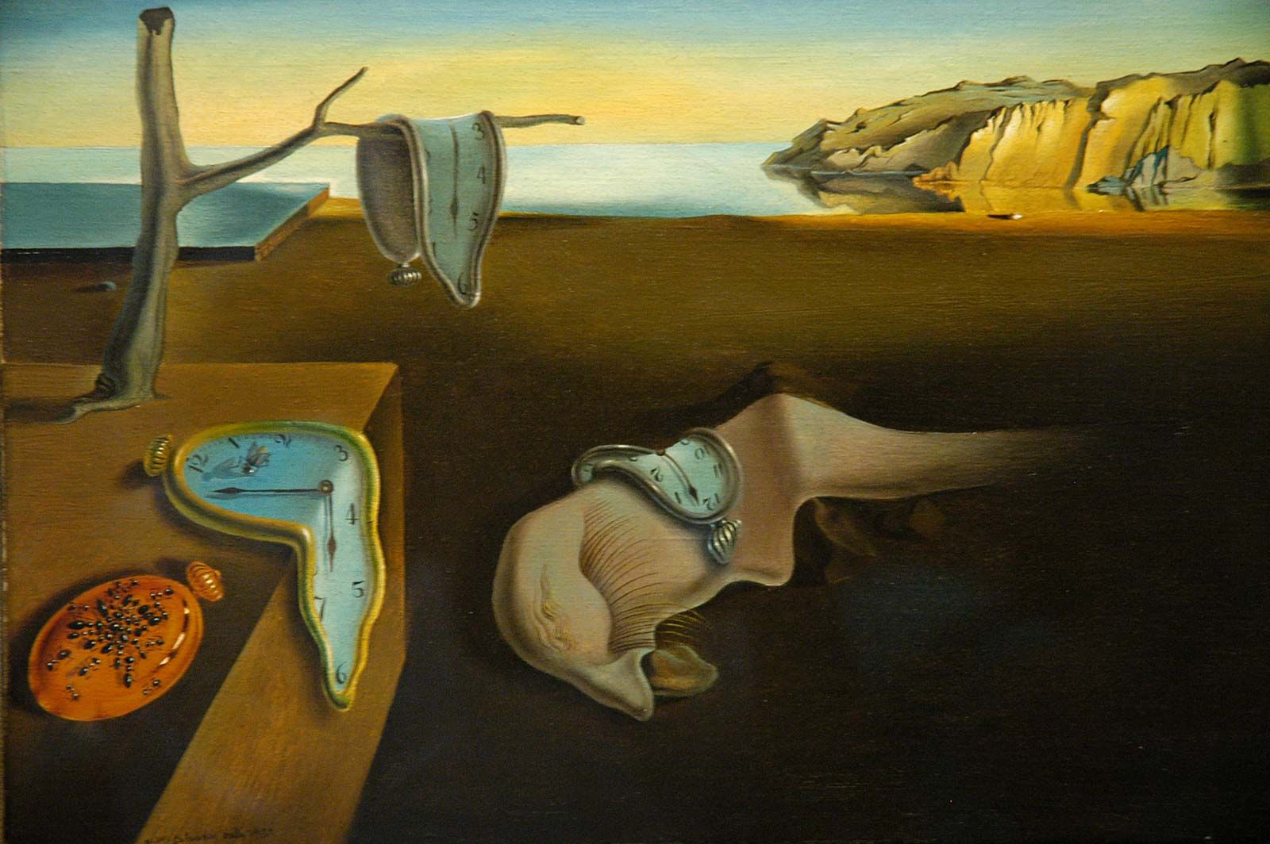
Notes:
Persistence of Memory
The Three Elephants

Slide 8
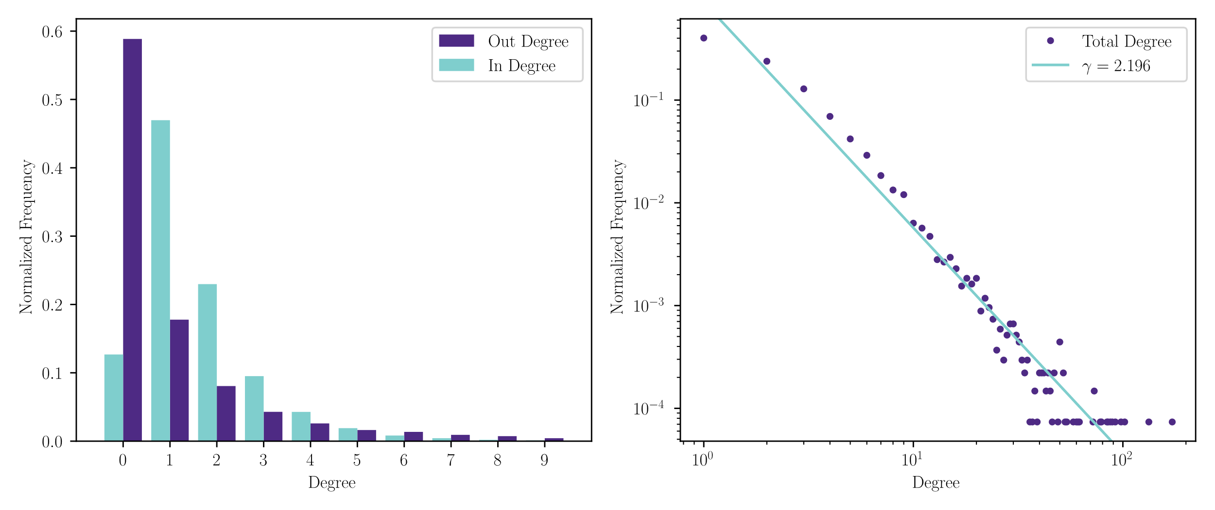

Slide 11
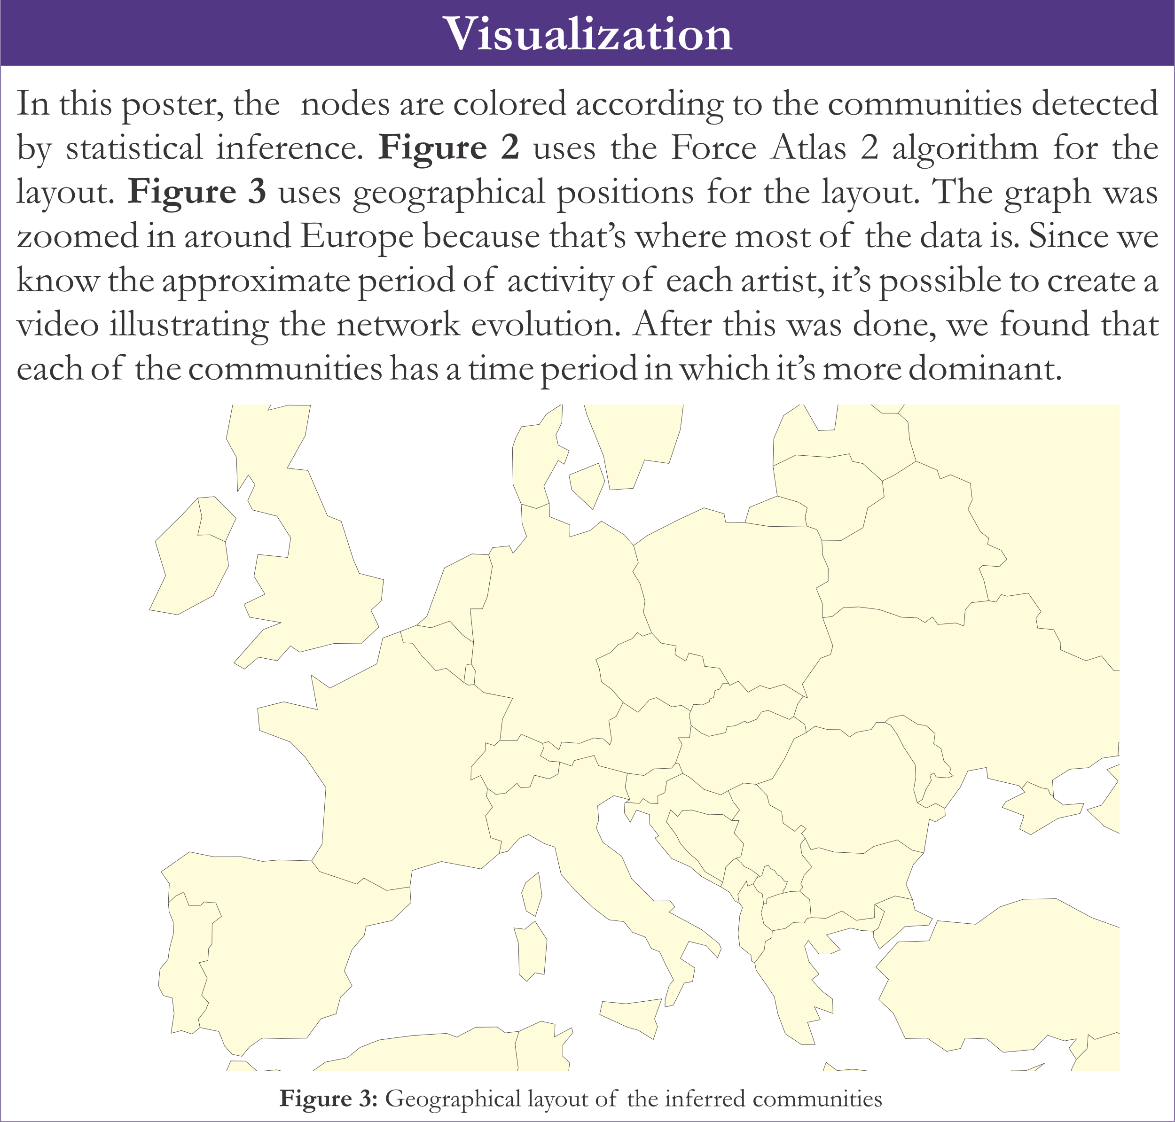
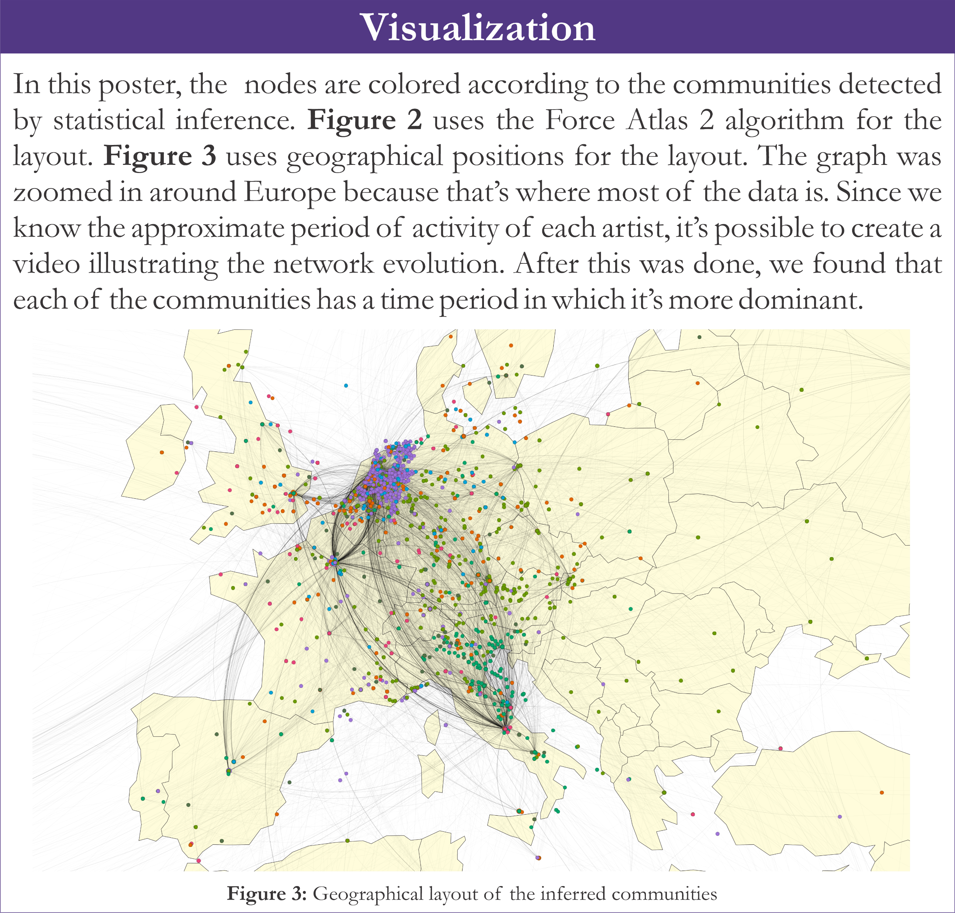

Slide 14
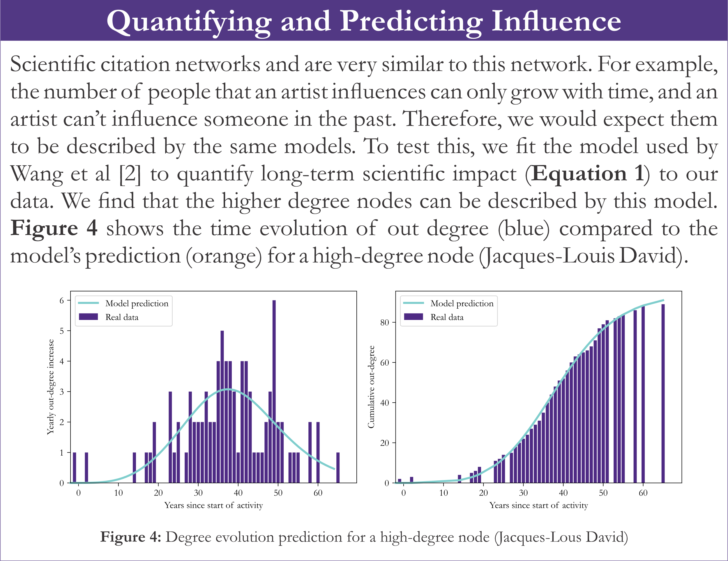

Slide 15
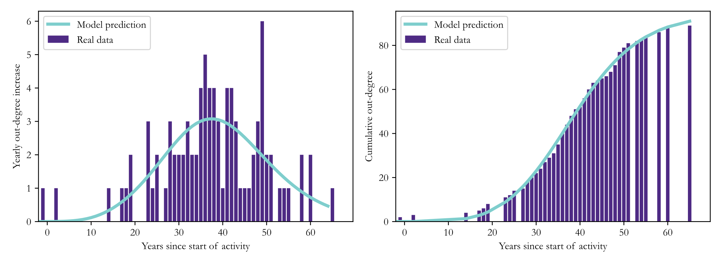

Slide 16
